Slide 1





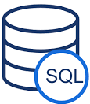




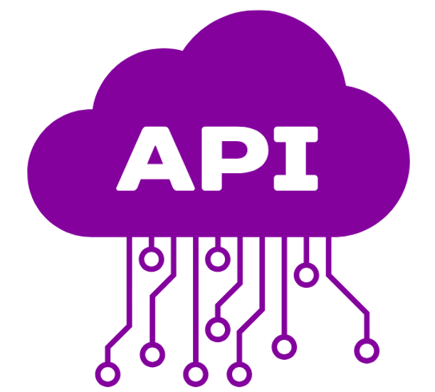




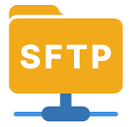

CRM Hub Landscape
SOURCE
END USER
MDH
MDH
MDH
MDH
MDH
MDH
CRM Hub
LCMS (Oracle DB)
Acquisition Layer
Curate Layer
Reporting Layer
LOD (SFTP)
Hybris (BLOB)
Adobe (SFTP)
ODE (ADLS)
Data Copy
CRM Reporting DB
CFW
CFW
CFW
D&A (ADLS)
Site Data (ADLS)
Staging
Curation
CFW
CFW
CRM DWH
PMS (GraphQL)
Landing
RAW
PREP
SharePoint
Export dataset
SSO
Microservice
Orchestrate
Orchestrate
Orchestrate
Orchestrate
Orchestrate
Daily delta
Daily delta
Historic Base
Merged Delta
Transformed data
CRM
CRM
CRM
CRM
CRM

